Slide 1


BANGLADESH ARMY UNIVERSITY OF SCIENCE AND TECHNOLOGY
House Price Prediction Using ML
Course Title: Machine Learning Sessional
Course Code: CSE 4140
Presented To: presented By:
Engr. Rohul Amin Rownak E Ikram(210201035)
Lecturer, CSE, BAUST
Nadim Reza G M Fakhrul Islam (210101005)
Lecturer, CSE, BAUST

Slide 2
Outlines
Introduction
Objectives
Related Works
Dataset
Methodology
Models Used
Comparison Table
Conclusion
Reference

Slide 3
Introduction
House price prediction is very important in real estate.
Prices change based on many factors like location, area, and rooms.
Manual price estimation is slow and not accurate.
Machine Learning helps to predict prices faster and more accurately.

Slide 4
Objectives
To predict house prices using machine learning
To analyze key features that affect the price
To apply ML algorithms for price prediction
To evaluate model performance using R² score and accuracy

Slide 5
Related works
In [1], Mallick et al., 2021 proposed a “House Price Prediction System Using ML Models.”
Shortcomings:
Basic preprocessing only
Location handling was limited
Fewer evaluation metrics

Slide 6
Related Works (Cont.)
In [2], Panda et al., 2021 developed a “Multiple Regression Model for Housing Price.”
Shortcomings:
No advanced ML models
Small dataset size
Overfitting not discussed

Slide 7
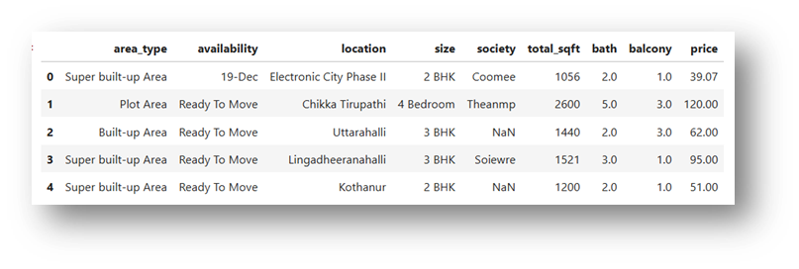

Dataset
Bengaluru House Price Dataset (Kaggle)
Total Samples: 13,320
Features:
Location
Total Square Feet
BHK
Bathrooms
Dataset required cleaning because of missing values and mixed formats.

Slide 8
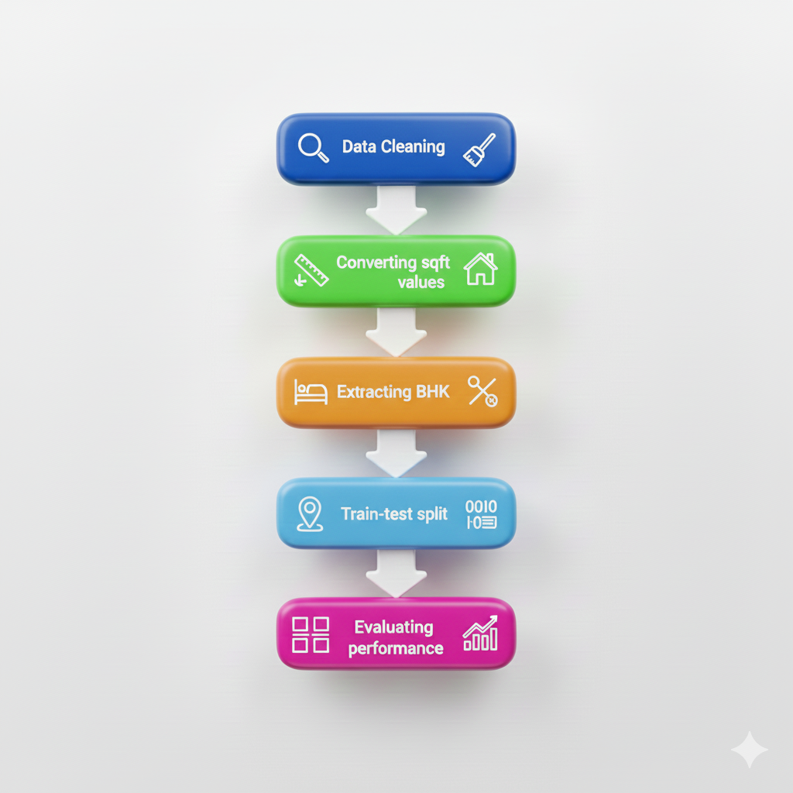
Methodology

Slide 9
Model Used
Linear Regression.
Lasso Regression.
Decision Tree .
Random Forest.

Slide 10
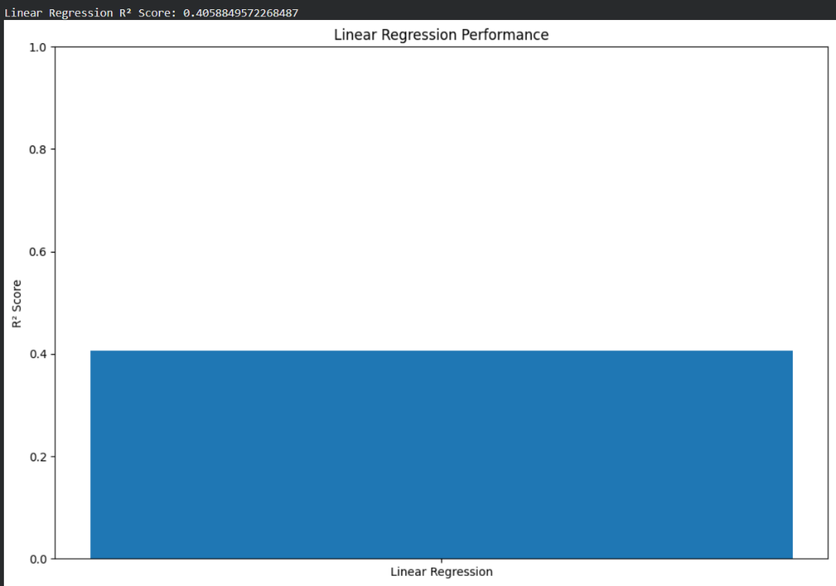
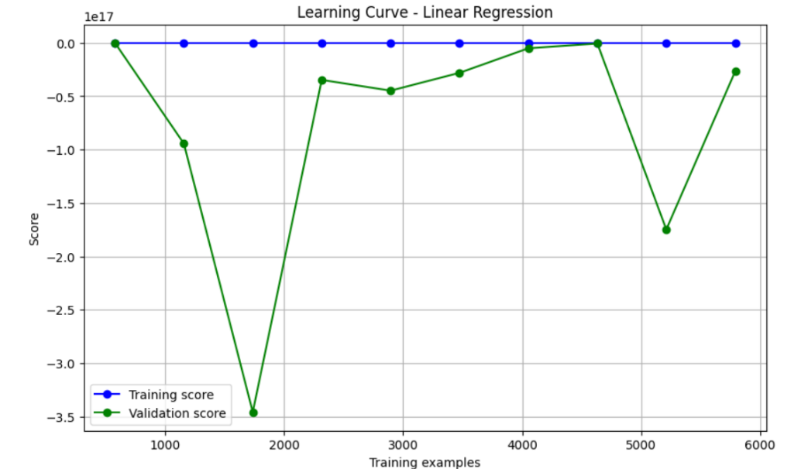
Model Used (Cont.)
Linear Regression model

Slide 11
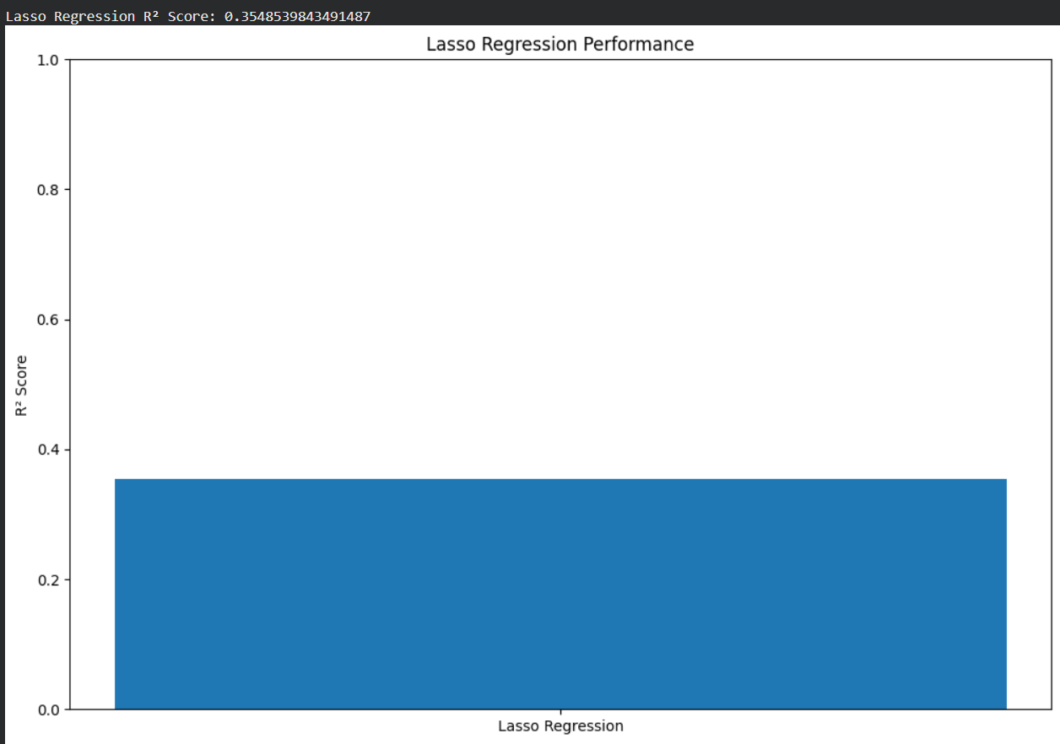
Model Used(Cont.)
Lasso Regression model

Slide 12
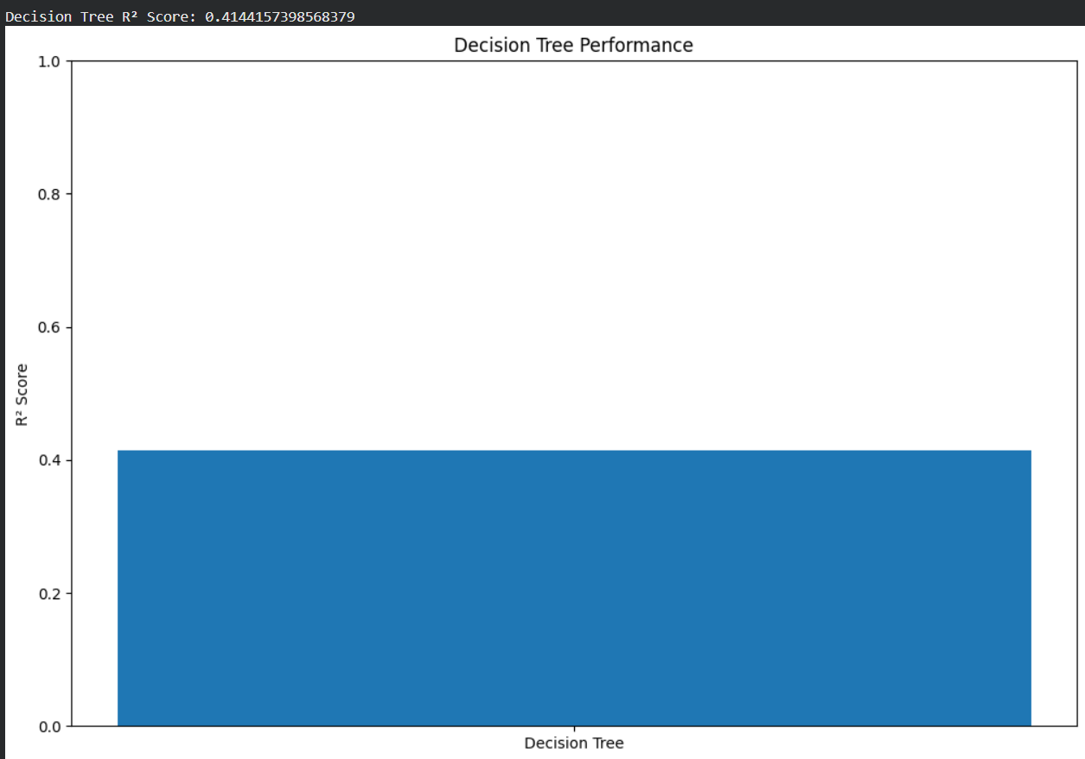
Model Used(Cont.)
Decision Tree

Slide 13
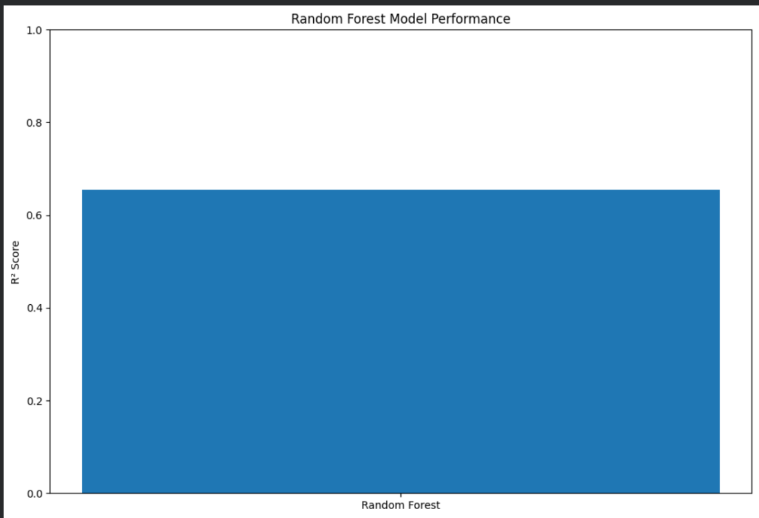
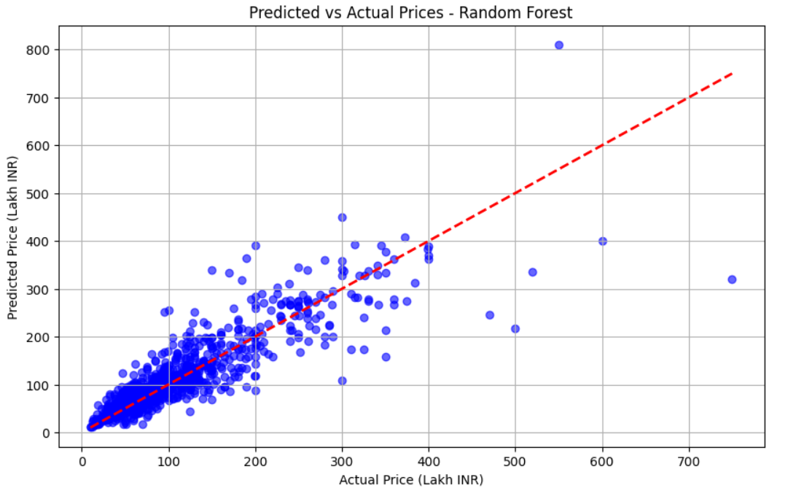
Model Used(Cont.)
Random Forest

Slide 14
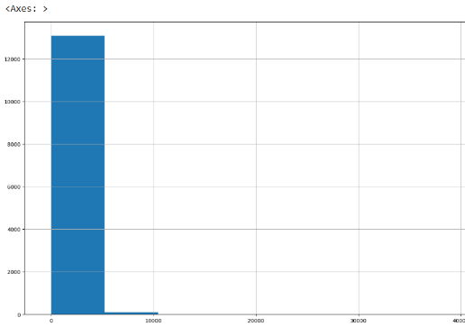
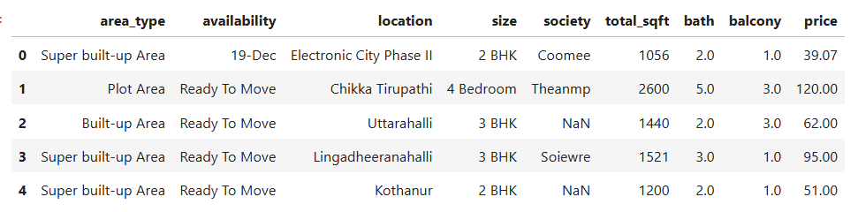
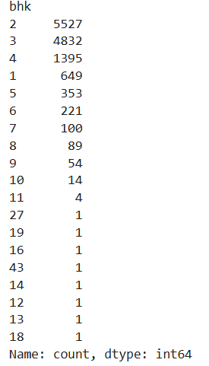
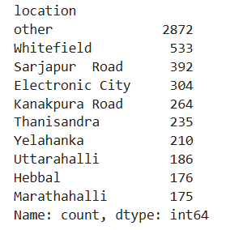
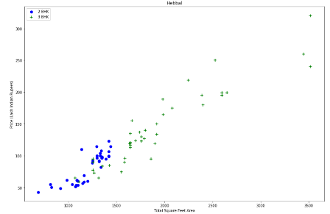
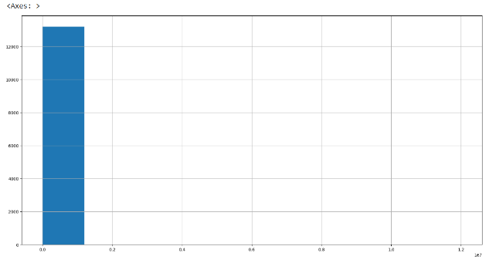
Model Used(Cont.)
Fig:Dataset Snapshot
Fig:Total Sqft Histogram
Fig:Total Sqft Histogram
Fig:BHK Distributions
Fig:Scatter Plot For Outliers
Fig:Price per Sqft Histogram
Fig:Top Locations

Slide 15
Comparison Table
Model | Accuracy (0–1) | Accuracy (%)
Linear Regression | 0.4508 | 84.78%
Lasso Regression | 0.3267 | 72.67%
Decision Tree | 0.4161 | 71.61%
Random Forest | 0.6543 | 88.25%

Slide 16
Conclusion
Random Forest gave the best performance in our dataset.
Cleaning and removing outliers improved accuracy a lot.
The model can predict house prices using location, sqft, BHK, and bathroom features.
This system can help in real-estate decision making.

Slide 17
Thank You

